Slide 1
Fruit Quality Detection
Review No. 3
Department of CSE

Slide 2

Department of Computer Science and Engineering
Fruit Quality Detection
PRESENTED BY
K. John Wesly
B. Naga Anil Kumar
V. Manoj Kumar
SK.T. Sharif
(22471A0598)
(22471A0579)
(22471A05D8)
(22471A05D5)
Under the Guidance of,
Abburi. Ramesh _{M. Tech},
Assistant Professor,
Department of Computer Science and Engineering,
Narasaraopeta Engineering College (Autonomous), Narasaraopet- 522 601.
Review No. 2
Department of CSE

Slide 3
OUTLINE
Abstract
Introduction
Literature Survey
Research Gaps
Problem Statement
Objectives
Block Diagram / Flow Diagram
Methodology
Implementation
Results and Analysis
Conclusion & Future Scope
References
Question and Answers
Acknowledgements
Review No. 2
Department of CSE

Slide 4
ABSTRACT
In agriculture, quality grading and classifying fruits are vital but pose challenges due to differing fruit appearances and an uneven distribution of classes. Existing solutions tend to focus on solving each of these problems, which affects the overall efficiency of the system. This paper proposes a dualstage framework based deep learning system for the integration of these two tasks. For classification of six fruit categories in the FruitNet dataset, a ConvNeXt-Tiny model pretrained on ImageNet is used, and an EfficientNetV2-B0 model that has undergone same-domain transfer learning is used for quality level grading (good, average, poor). AugMix, CutMix, and MixUp advanced augmentations are applied to enhance the robustness.With an overall accuracy of 99.9%, the proposed system is superior to the existing approaches. Additionally, its modular and lightweight architecture allows for real-time agricultural automation even on devices with limited resources.
Review No 2
Department of CSE

Slide 5
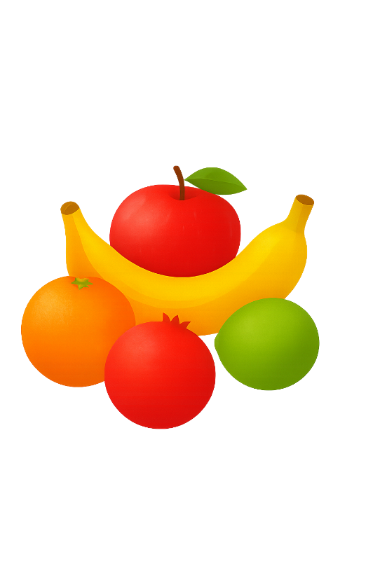
INTRODUCTION
Brief introduction to the project
Fruit quality assessment plays a vital role in agriculture and supply chains.
Traditional image processing techniques struggle with variations in lighting, texture, and shape.
Deep learning models such as ConvNeXt-Tiny and EfficientNetV2-B0 are integrated to classify fruit types and grade their quality (good, average, poor).
The system achieves 99.9% accuracy, making it suitable for real-world agricultural automation.
Review No 2.
Department of CSE

Slide 6
INTRODUCTION
Motivation behind the project
Current fruit inspection methods are manual, time-consuming, and inconsistent.
Many existing systems handle only one fruit type or perform only classification without grading.
Need for a dual-stage deep learning system that can both classify and grade multiple fruits simultaneously.
Ensures fair pricing, better storage, and reduced food waste through automated quality control.
Review No 2
Department of CSE

Slide 7
INTRODUCTION
Importance and Relevance
Supports precision agriculture and smart farming initiatives.
Scalable for both industrial sorting lines and small-scale farms.
Incorporates AugMix, CutMix, and MixUp augmentations to handle real-world variations.
Demonstrates how AI can revolutionize agricultural automation with affordable and efficient solutions.
Reduces manual labor dependency, minimizing human error and saving time in fruit inspection processes.
Review No 2
Department of CSE

Slide 8
LITERATURE SURVEY
No | Title | Author | Journal Name & Year | Methodology Adapted | Key Findings | Gaps
1 | Classification of Fruits and its Quality Prediction using Deep Learning | Dr. K. Sangeetha Dr. P. Vishnu Raja Siranjeevi S Suman J Rohith S | IEEE (2024) https://ieeexplore.ieee.org/document/10511141 | Collected and prepared fruit images. Trained CNN model for fruit classification. Detected ripeness using OpenCV. | CNN accurately classifies fresh and rotten fruits. OpenCV detects ripeness by color. System gives high accuracy and reliability. | Small dataset limits accuracy. Uses only color and shape features. Ignores internal fruit quality.
2 | Fruit Classification Based On Freshness | Mallegowda M Sanskar R G Vishveshwara N Safwan G A | IEEE (2024) https://ieeexplore.ieee.org/document/10704151 | VGG16 classified fruits. Web app checked freshness. | VGG16 gave 95% accuracy. Works fast on web and mobile. | Limited fruit types used. Needs better real-time detection.
3 | Fruit Quality Detection: An Automated Approach | Harshalatha Y Akshay A B Sathvik G Gnaneshwara T V Maruthi | IEEE (2024) https://ieeexplore.ieee.org/document/10846976 | Image Acquisition & Preprocessing Automation & Sorting Feature Extraction & Classification | 99.1% accuracy in detection. Used color and shape for sorting. Less manual work, faster process. | Small dataset, few fruit types. Only color and shape used. May fail in real conditions.
Review No. 2
Department of CSE

Slide 9
LITERATURE SURVEY
No | Title | Author | Journal Name & Year | Methodology Adapted | Key Findings | Gaps
4 | Image-based Fruit Quality Assessment using Deep Learning Algorithms | Lokkhesh Annamalai S. K. P. Vinothiyalakshmi | IEEE (2024) https://ieeexplore.ieee.org/document/10841700 | Used CNN models to classify fruit quality. Predicted fruits as fresh, ripe, or rotten. | CNN models accurately assess fruit quality. Achieved high accuracy in classifying fresh, ripe, and rotten fruits. | Limited dataset reduces model accuracy. Focuses only on external fruit features.
5 | Fruit Classification and Ripeness Estimation using Deep learning Models | Asha Gowda Karegowda Hemashree D. U. S. J. Sheela | IEEE (2024) https://ieeexplore.ieee.org/document/10817041 | Collected fruit images and preprocessed data. Used CNN models for ripeness classification. DenseNet201 achieved 92% accuracy. | DenseNet201 gave the best accuracy of 92%. CNNs effectively classified fruits by ripeness. Method improves automation in agriculture. | Limited to few fruit types. Focuses only on external features. Lacks real-time implementation.
Review No 2
Department of CSE

Slide 10
RESEARCH GAPS
Existing models focus mainly on disease classification, but lack fruit quality grading (e.g., fresh, average, rotten).
Most studies use limited datasets with controlled environments not suitable for real-world lighting and background variations.
Feature extraction techniques (like texture and color features) in traditional ML models are less robust compared to modern CNN-based methods.
Current CNN architectures have high computational cost, making them unsuitable for real-time mobile or IoT-based applications.
Transfer learning models (e.g., VGG, ResNet, EfficientNet) are not fine-tuned for same-domain fruit datasets, limiting accuracy.
Review No. 2
Department of CSE

Slide 11
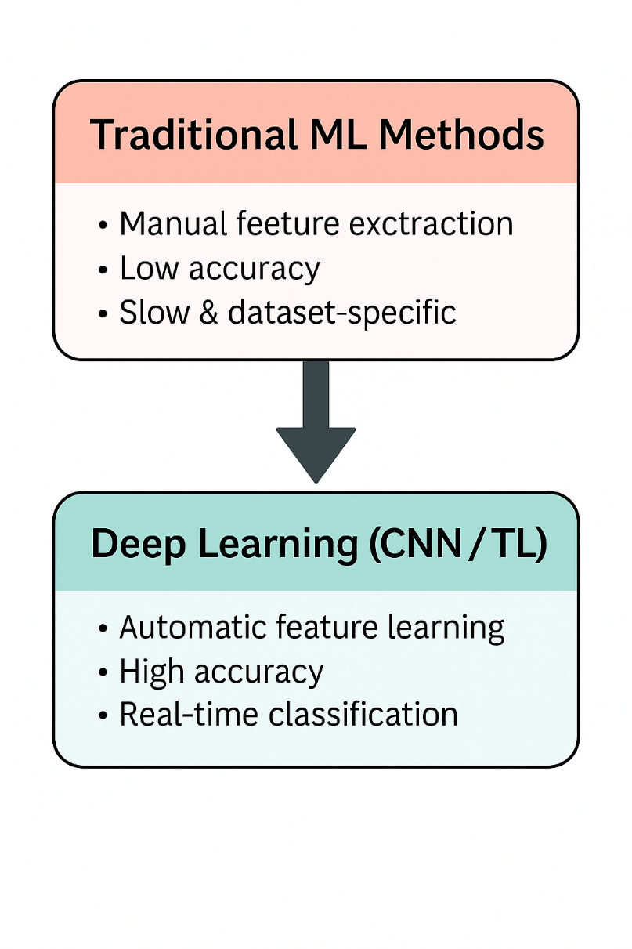
RESEARCH GAPS
Review No. 2
Department of CSE

Slide 12
PROBLEM STATEMENT
Identifying the quality of fruits manually is time-consuming, subjective, and inaccurate.
Existing computer-based systems focus mainly on detecting diseases rather than grading fruit quality.
Many existing models fail to work accurately under different lighting conditions or real-world environments.
Current deep learning methods are often complex and computationally expensive, making them unsuitable for real-time use.
Therefore, there is a need for an automated, reliable, and lightweight system to assess fruit quality effectively using deep learning techniques.
Review No. 2
Department of CSE

Slide 13
OBJECTIVES
To design and develop a deep learning-based model capable of predicting the quality of fruits (Fresh, Average, Rotten) with high accuracy.
To build a lightweight and efficient CNN architecture (using transfer learning like EfficientNetV2B0) for real-time classification.
To prepare a diverse dataset of fruit images under varying lighting, background, and environmental conditions for robust model training.
To perform evaluation and comparison of the proposed model using metrics such as accuracy, precision, recall, and F1-score.
Review No.21
Department of CSE

Slide 14
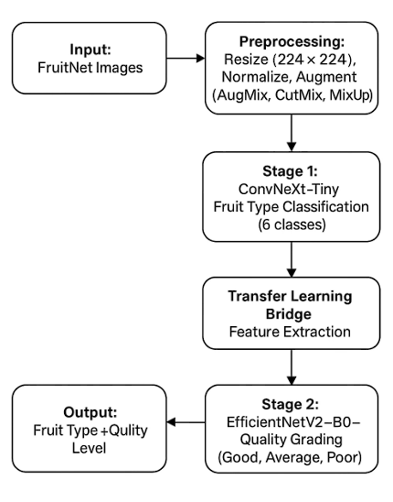
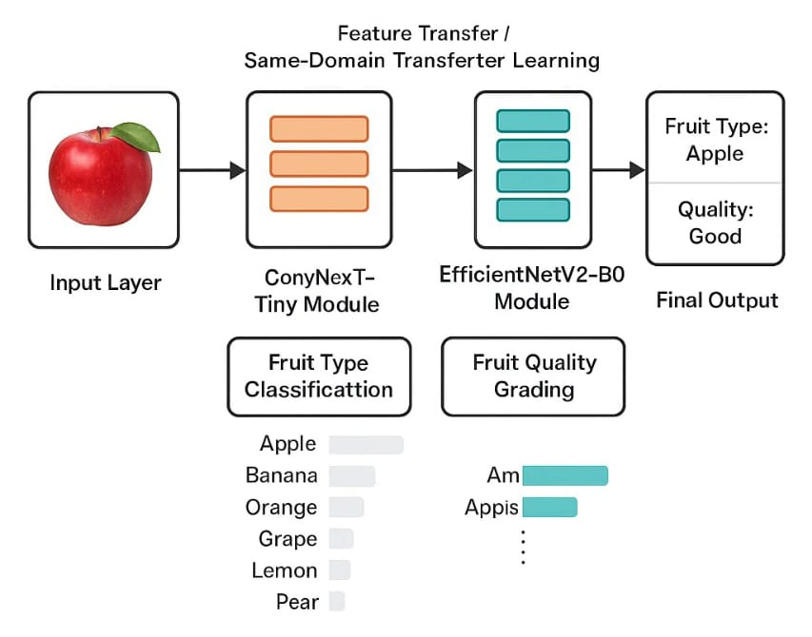
BLOCK DIAGRAM OR FLOW DIAGRAM
b. Model Architecture: Dual-stage pipeline using ConvNeXt-Tiny and EfficientNetV2-B0
a. Block diagram for Complete Workflow
Review No. 2
Department of CSE

Slide 15
METHODOLOGY
1. Dataset Preparation
The FruitNet dataset was used, containing six fruit types Apple, Banana, Orange, Pomegranate, Lime, and Guava — each categorized into three quality levels (Good, Average, Poor).
Images were resized to 224×224×3, normalized to [0,1], and split in a 70:10:20 ratio for training, validation, and testing.
Data imbalance was handled using advanced augmentations AugMix, CutMix, and MixUp — to simulate real-world conditions.
Review No. 2
Department of CSE

Slide 16
METHODOLOGY
2. Data Preprocessing
Image cleaning: Removed corrupted and mislabeled files.
Standardized input size and color normalization.
Label encoding using ImageFolder for class mapping.
Applied augmentation for variations in lighting, angle, and texture to enhance generalization.
We also used advanced augmentation techniques like AugMix, CutMix, and MixUp to improve the model’s ability to handle real-world variations in lighting, background, and camera angles.
Review No. 2
Department of CSE

Slide 17
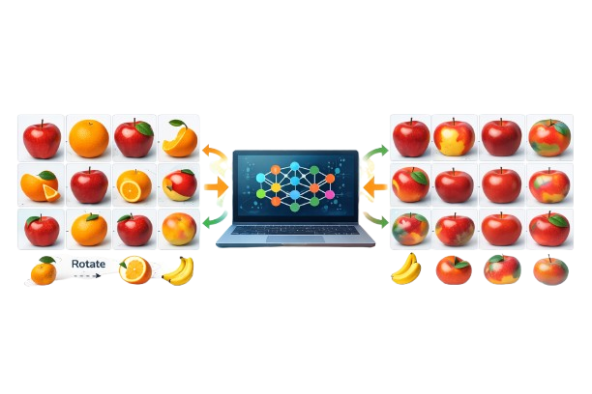
METHODOLOGY
2.1 Data augmentation techniques
Boosting Dataset Diversity & Model Performance
Data augmentation is a technique used to artificially increase the size and diversity of a dataset by generating modified versions of existing data without collecting new data.
Uses transformations such as:
Rotation
Flipping
Blurring
Color variation
Image mixing (CutMix, MixUp, AugMix)
Review No. 2
Department of CSE

Slide 18
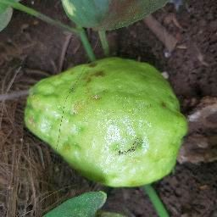
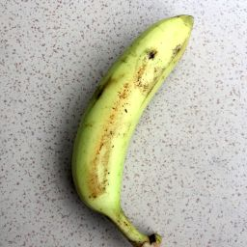
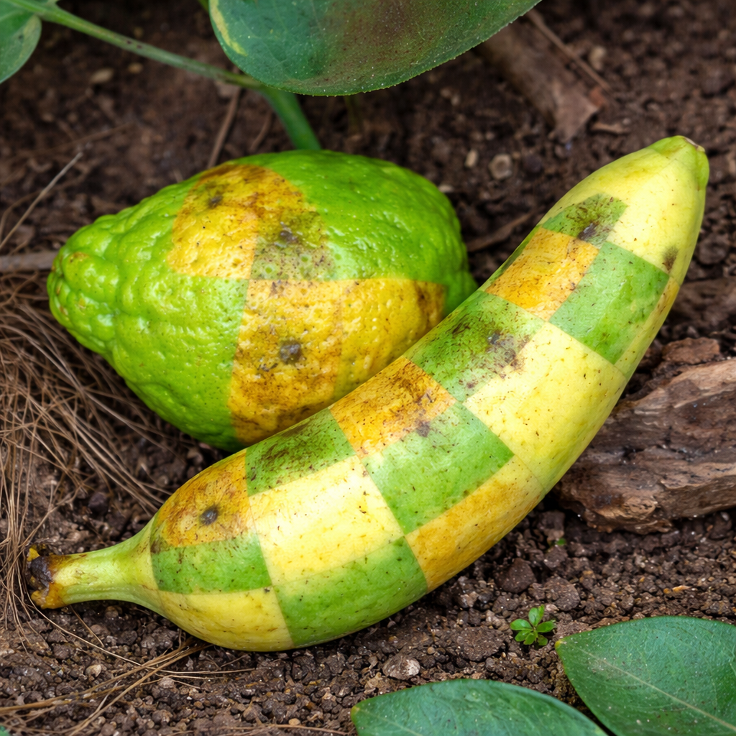
METHODOLOGY
2.1.1 CutMix
₊
Random Patch Cut
Cut Mix
Original Image A
Original Image B
CutMix Augmented Image
CutMix augmentation combines two training images by cutting a random region from one image and pasting it onto another image.
The final label is mixed proportionally based on the area of the pasted region.
Review No. 2
Department of CSE

Slide 19
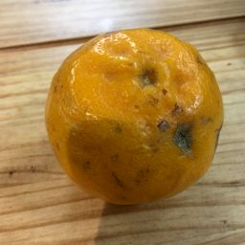
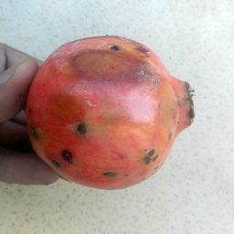
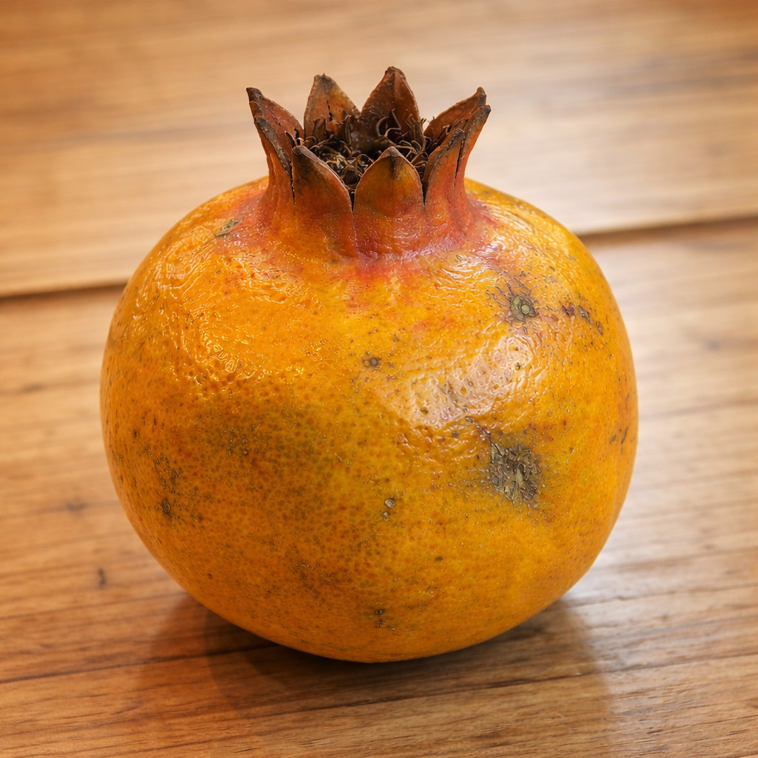
METHODOLOGY
2.1.2 MixUp
₊
Linear Image Blending
MixUp
Original Image A
Original Image B
CutMix Augmented Image
MixUp augmentation combines two training images by linearly blending their pixel values using a mixing coefficient. The final label is mixed proportionally using the same weighting factor.
Review No. 2
Department of CSE

Slide 20
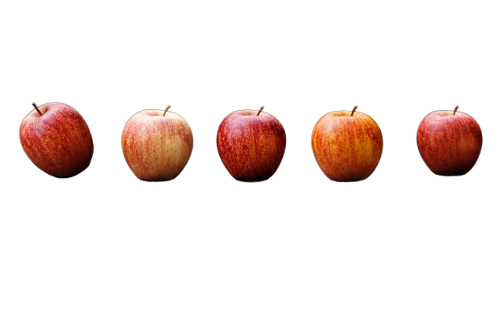
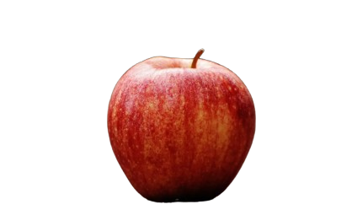
METHODOLOGY
2.1.3 AugMix
Multi-Augmentation Strategy in AugMix
=
Original Image
Rotation Brightness Contrast Colour Jitter Translation
Change Adjustment
AugMix augmentation combines multiple randomly augmented versions of a training image by mixing them together along with the original image. The final label remains unchanged, improving model robustness and generalization against image distortions.
Review No. 2
Department of CSE

Slide 21
METHODOLOGY
3.Model Architecture
Stage 1: Fruit Classification
Model: ConvNeXt-Tiny (pretrained on ImageNet)
Task: Classify images into six fruit types.
Optimizer: Adam (lr=1e-4) | Loss: Categorical Crossentropy
Trained for 50 epochs with early stopping and checkpointing.
Stage 2: Quality Grading
Model: EfficientNetV2-B0 (fine-tuned using transfer learning).
Task: Predict fruit quality (Good, Mixed, Bad).
Reused extracted features from Stage 1 for same-domain transfer learning.
Review No. 2
Department of CSE

Slide 22
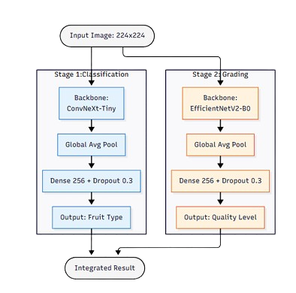
METHODOLOGY
3.1 Two-Stage Deep Learning Model Architecture
Stage 1: Fruit Classification
Backbone: ConvNeXt-Tiny
Pretraining: ImageNet
Global Average Pooling: Reduces spatial dimensions
Dense Layer: 256 neurons + Dropout (0.3)
Output: Fruit Type
Apple, Banana, Guava, Lemon, Lime, Orange
Stage 2: Quality Grading
Backbone: EfficientNetV2-B0
Approach: Transfer learning (same-domain features)
Global Average Pooling: Improves generalization
Dense Layer: 256 neurons + Dropout (0.3)
Output: Quality Level
Good,Average,Poor .
Review No. 2
Department of CSE

Slide 23
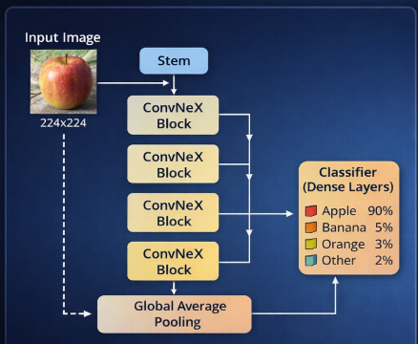
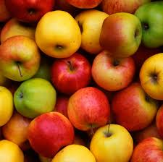
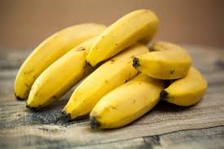
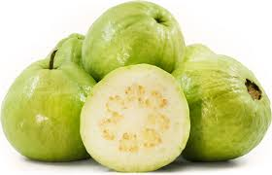
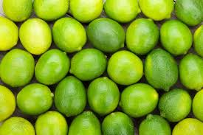
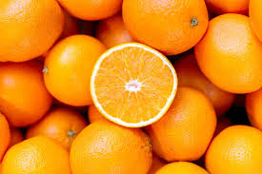
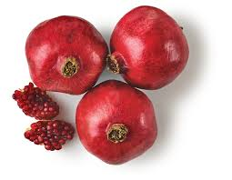
METHODOLOGY
3.1.1 Fruit Type Classification Using ConvNeXt-Tiny
ConvNeXt-Tiny is used for fruit type classification
Learns color, texture, and shape features
Lightweight and efficient for real-time prediction
The ConvNeXt-Tiny model is trained to classify and predict only the following six fruit categories:
ConvNeXt-Tiny Architecture for Fruit Type Classification
Review No. 2
Department of CSE

Slide 24
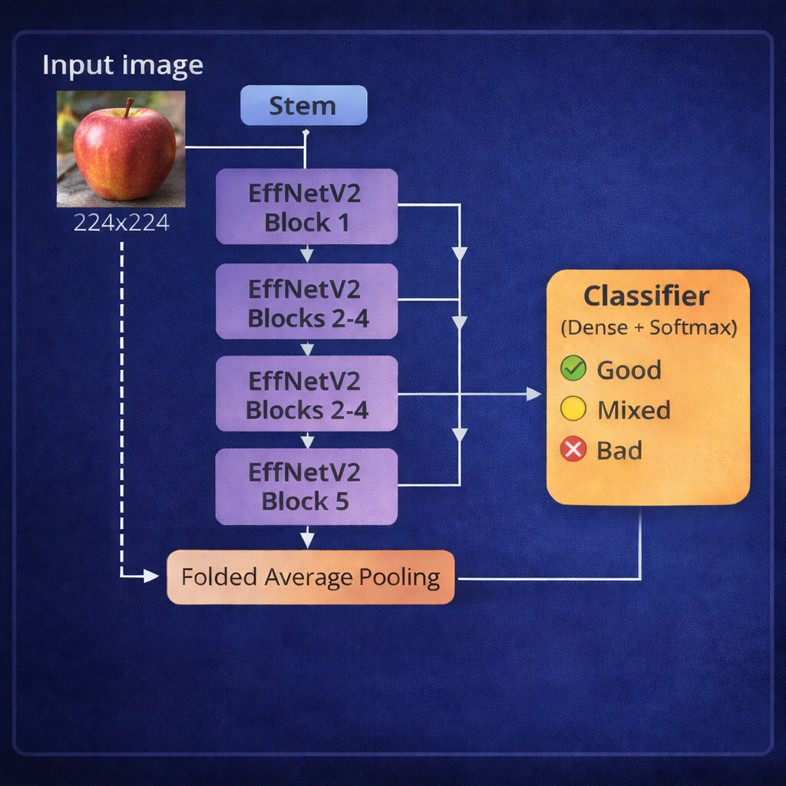
METHODOLOGY
3.1.2 Fruit Quality Prediction Using ConvNeXt-Tiny
EfficientNetV2 is used for fruit quality prediction
Learns surface defects, texture, and freshness patterns
The EfficientNetV2 model is trained to classify and predict fruit quality levels into the following categories::
Good
Apple
Good
Bad
Mixed
Banana
Good
Bad
Mixed
Guava
Good
Bad
Mixed
Lime
Good
Bad
Mixed
Orange
Good
Bad
Mixed
Pomegranate
EfficientNetV2 Architecture for Fruit Quality Prediction
Good
Bad
Mixed
Review No. 2
Department of CSE

Slide 25
METHODOLOGY
4. Frameworks and Tools Used.
Image Processing: Utilized OpenCV and PIL for image loading, resizing, and color normalization.
Data Manipulation: Used NumPy and Pandas for handling datasets, array operations, and preprocessing tasks.
Data Augmentation: Applied Albumentations, TensorFlow, and KerasCV to perform rotation, zoom, brightness, and mixing techniques.
Model Training: Implemented using TensorFlow and Keras frameworks for deep learning model development and fine-tuning.
Visualization: Used Matplotlib and Seaborn for analyzing model accuracy, loss curves, and confusion matrices.
Model Export: Saved trained models in .keras and ONNX formats for easy deployment and integration.
Review No. 2
Department of CSE

Slide 26
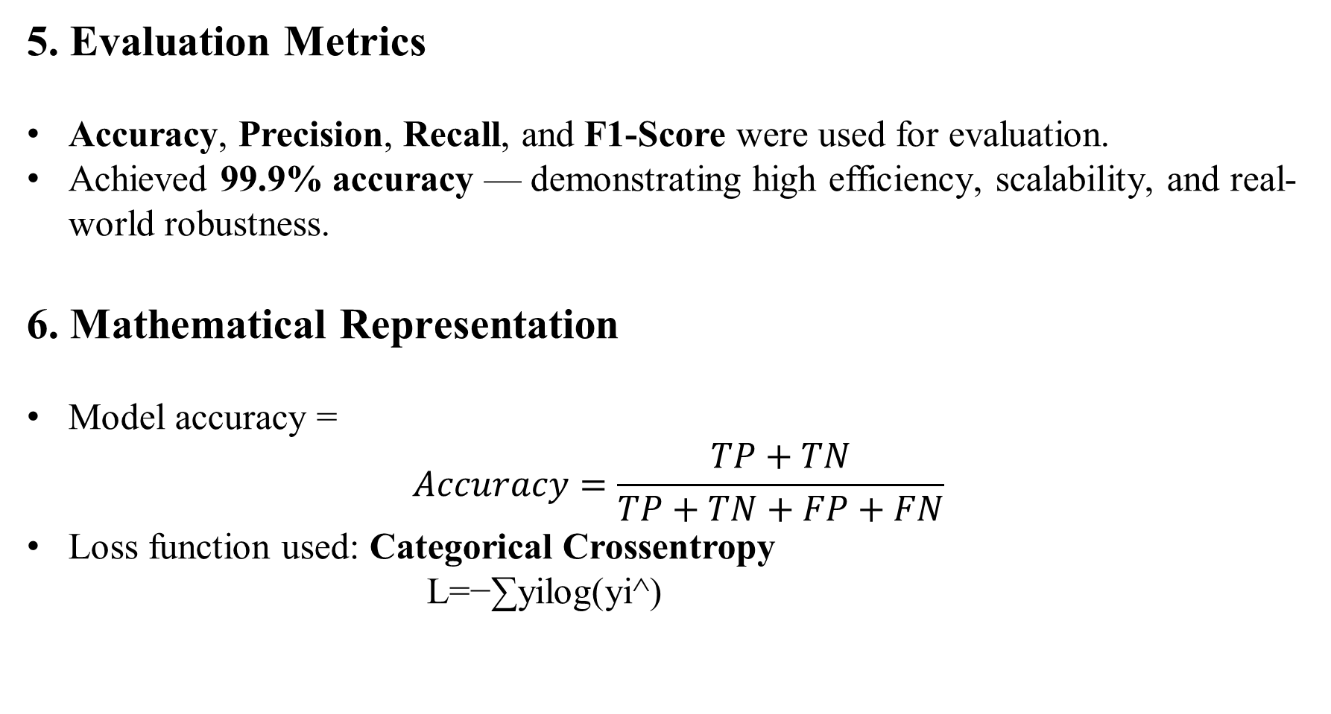
METHODOLOGY
5. Evaluation Metrics
Accuracy, Precision, Recall, and F1-Score were used for evaluation.
Achieved 99.9% accuracy — demonstrating high efficiency, scalability, and real-world robustness.
6. Mathematical Representation
Model accuracy =
$$Accuracy=\frac{TP+TN}{TP+TN+FP+FN}$$
Loss function used: Categorical Crossentropy
L=−∑yi​log(yi​^​)
Review No. 2
Department of CSE

Slide 27
IMPLEMENTATION
Hardware Specifications:
Processor : Intel Core i3 Gen or above
RAM : 8GB (4 GB usable)
System Type : 64-bit operating system
Software Specifications:
Operating System : Windows 10 or above
Coding Language : Python
Python Distribution: Google COLAB
Review No. 2
Department of CSE

Slide 28
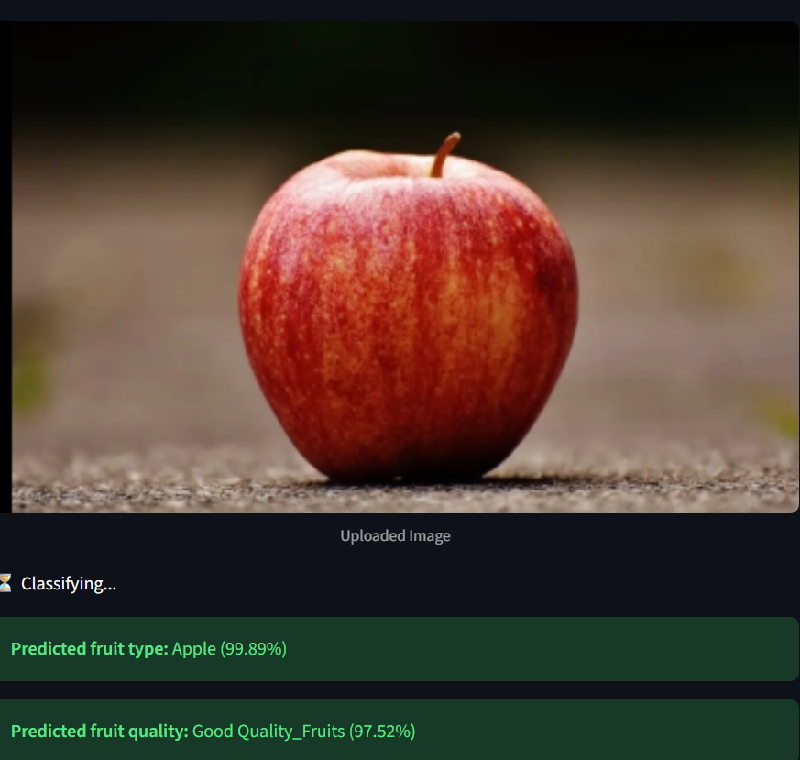
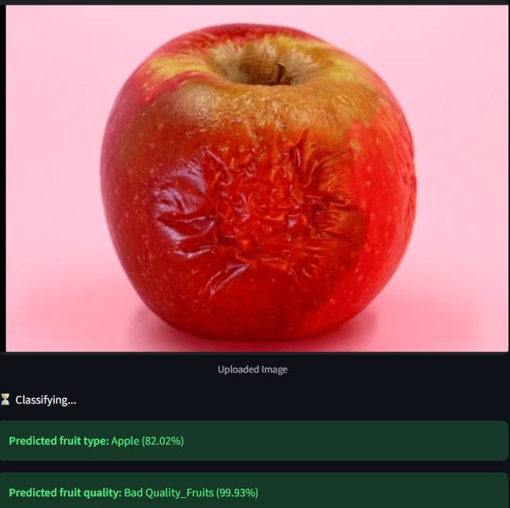
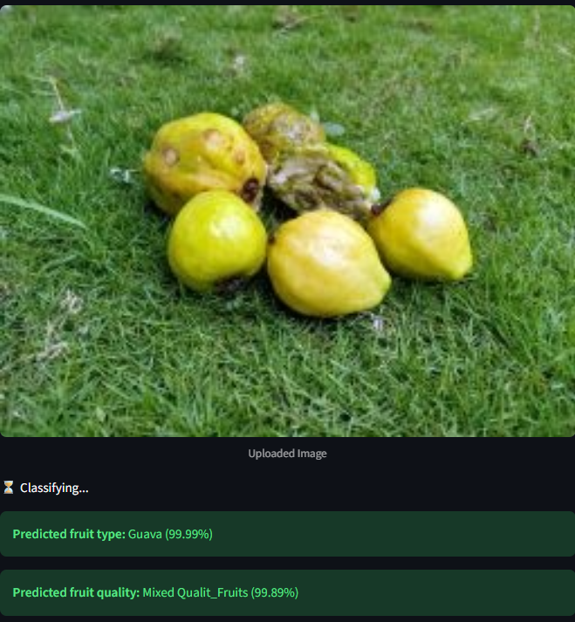
RESULTS & ANALYSIS
Fruit Type and Quality Classification
Review No. 2
Department of CSE

Slide 29
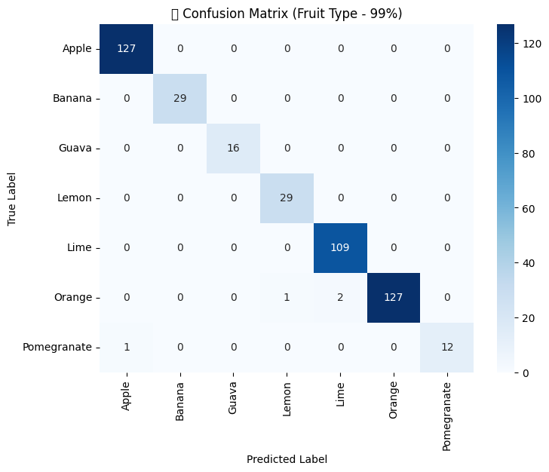
RESULTS & ANALYSIS
Confusion Matrix – Fruit Type Classification
The model achieved 99% accuracy in fruit type classification.
Most fruit types (Apple, Orange, Lime, Lemon) were perfectly classified.
Minimal misclassification observed in Pomegranate and Orange categories.
Indicates excellent generalization and strong performance across multiple fruit types.
Review No. 2
Department of CSE

Slide 30
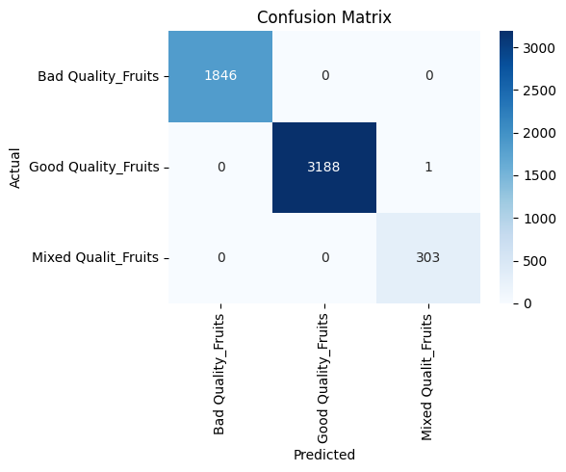
RESULTS & ANALYSIS
Confusion Matrix – Fruit Quality Classification
The model achieved near-perfect classification across all three fruit quality categories — Good, Bad, and Mixed.
Out of 5,338 total samples, only one image was misclassified, showing exceptional model accuracy (~99.98%).
Strong diagonal dominance confirms excellent generalization and robust feature extraction by the EfficientNetV2B0 model.
Review No. 2
Department of CSE

Slide 31
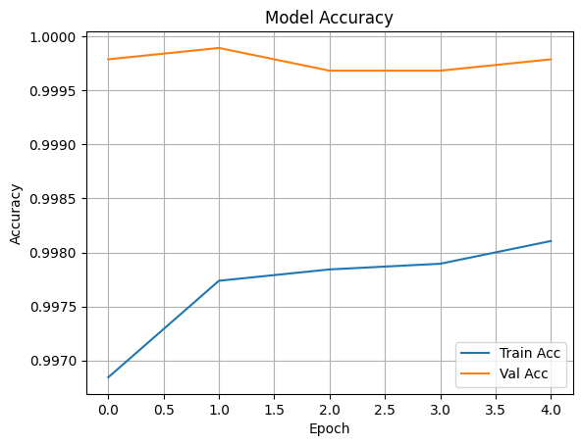
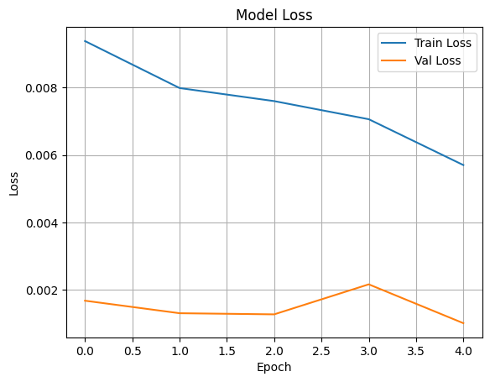
RESULTS & ANALYSIS
Training vs Validation Accuracy Curve
Training vs Validation Loss Curve
Review No . 2
Department of CSE

Slide 32
CONCLUSION and FUTURE SCOPE
The model accurately classifies fruit type and quality with over 99% accuracy.
It provides a fast and automated solution for fruit quality assessment.
The system is robust and reliable across different fruit types and environments.
Integrate with IoT or mobile apps for real-time fruit grading.
Extend the dataset to more fruits and real-world conditions
Add explainable AI for better understanding of model decisions.
Optimize the model for edge devices and on-field deployment.
Review No. 2
Department of CSE

Slide 33
REFERENCES
G. Singh, K. Guleria, and S. Sharma, “Advanced fruit sorting: Pretrained resnet50 model for rotten and fresh fruit classification,” in 2024 4th Asian Conference on Innovation in Technology (ASIANCON), 2024, pp. 1–5.
R. Raut, A. Jadhav, C. Sorte, and A. Chaudhari, “Classification of fruits using convolutional neural networks,” in 2022 Second International Conference on Advances in Electrical, Computing, Communication and Sustainable Technologies (ICAECT), 2022, pp. 1–4.
H. Q. Tran, Q. N. Le, C. Ha, T. Van Nguyen, and Q. P. Tan, “A study of cantaloupe fruit classification using deep learning algorithms,” in 2024 International Conference on Control, Robotics and Informatics (ICCRI), 2024, pp. 1–6.
A. G. Karegowda, H. D U, and S. J. Sheela, “Fruit classification and ripeness estimation using deep learning models,” in 2024 8th International Conference on Computational System and Information Technology for Sustainable Solutions (CSITSS), 2024, pp. 1–6.
[5] S. T. S, A. K. R. J, B. S. D, and S. K. B. N, “Fruit quality identification using deep learningtechniques,” in 2022 Fourth International Conference on Emerging Research in Electronics, Computer Science and Technology (ICERECT), 2022, pp. 1–4.
Review No. 2
Department of CSE

Slide 34

QUESTIONS and ANSWERS
Review No. 2
Department of CSE

Slide 35
ACKNOWLEGEMENTS
Grateful to the college management and project guide for their constant guidance and encouragement.
Thanks to all team members and faculty for their valuable support and technical assistance.
Sincere appreciation to the conference committee for the opportunity to present this research work.
For further inquiries, contact:
sireeshamoturi@gmail.com
abburi.ramesh@gmail.com
johnwesleykambhampati@gmail.com
manojkumarvinnakota@gmail.com
sharif55167849@gmail.com
anilkumarbokkisam820@gmail.com
Review No. 2
Department of CSE

Slide 36

Review No. 2
Department of CSE

